Slide 1
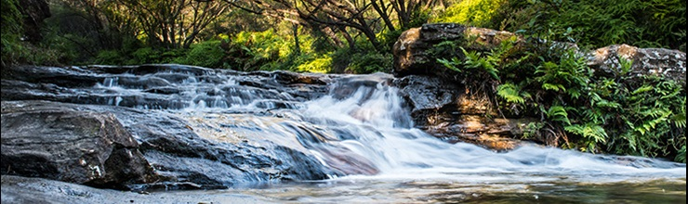
ECOFUTURES Incorporating nutrient flow into overland flow and groundwater models to better predict ecological response across large scales
Todd Steissberg and Billy Johnson

Slide 2
Background
Nutrient flow impacts how species utilize their resources across large scales. Invasive species can capitalize on changes in nutrient dynamics and can outcompete other species.
Currently, within spatially explicit (gridded) watershed models, nutrient flow is not simulated across watershed scales, which prevents accurate prediction of how species will spatially distribute themselves across a landscape.
To address this challenge, we will incorporate nutrient flow into GSSHA and will then couple ERDC’s multi-species vegetation model into the GSSHA framework.
We will leverage existing ERDC relationships with the San Antonio River Authority to optimize proof-of-concept design.

Slide 3
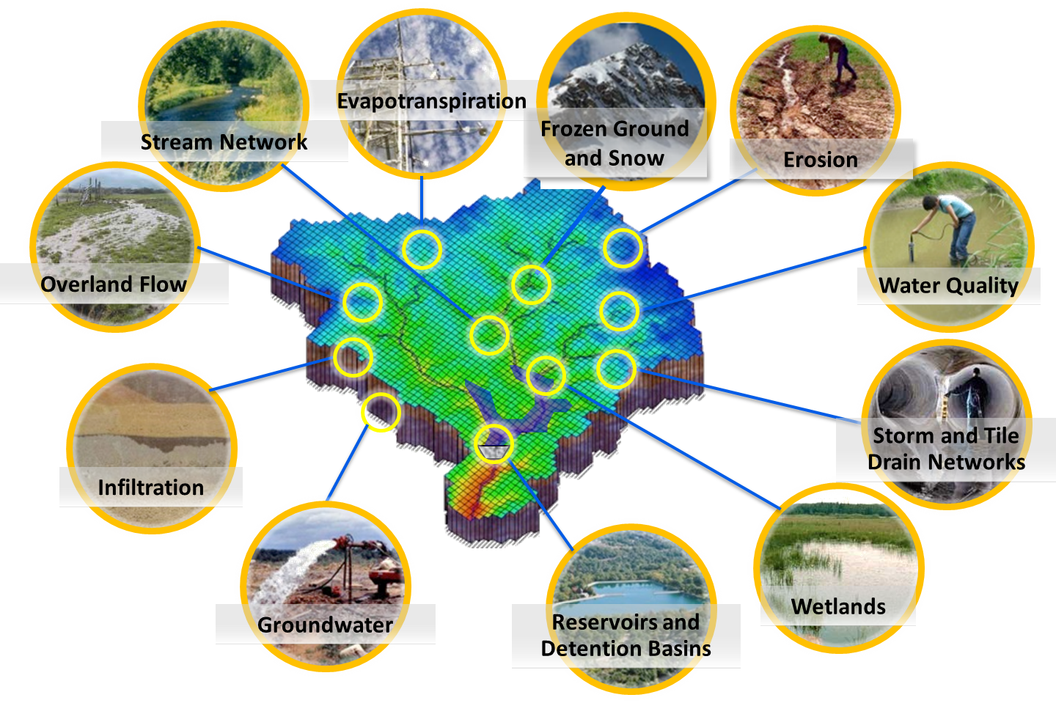
Models
GSSHA is a multidimensional modeling technology, developed by the U.S. Army Engineer Research and Development Center (ERDC), which uniformly couples overland, surface, and subsurface flow for accurate watershed simulation. It is a physics-based, distributed, hydrologic, sediment and constituent fate and transport model that features the following:
Two-dimensional (2D) overland flow and groundwater and one-dimensional (1D) stream flow and soil moisture
Fully dynamic pipe networks for urban and agricultural drainage systems
Wetland peat layer hydrodynamics and several in-stream weir and culvert models
Lakes, detention basins, levees, rating and rule curve releases
Boundary conditions for hurricane storm surge or levee breach inundation modeling
Full coupling among groundwater, vadose zone, streams, and overland flow
Full-Gr-coupled groundwater to surface-water interaction to model Hortonian and non-Hortonian basins

Slide 4
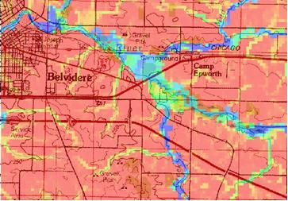
Models
GSSHA can be used as an episodic or continuous model where soil surface moisture, groundwater levels, stream interactions, and constituent fate are continuously simulated.
The fully coupled groundwater to surface-water interaction allows GSSHA to model basins in both arid and humid environments. The model simulates sediment and constituent fate and transport in shallow soils, overland flow planes, streams, and channels.

Slide 5
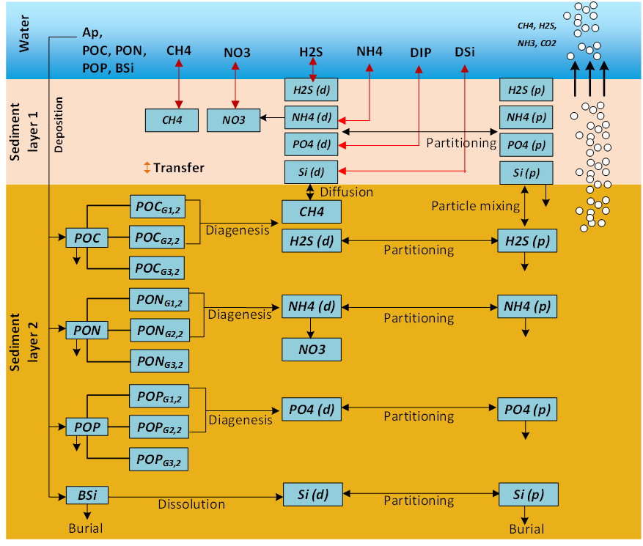
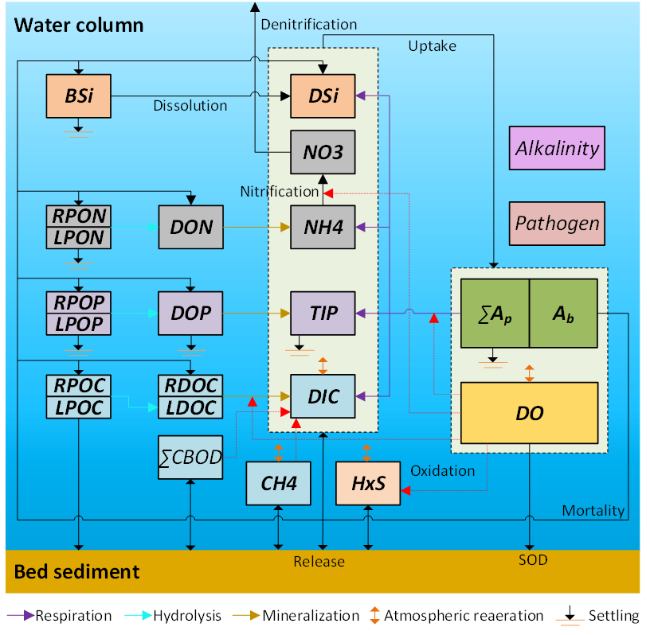
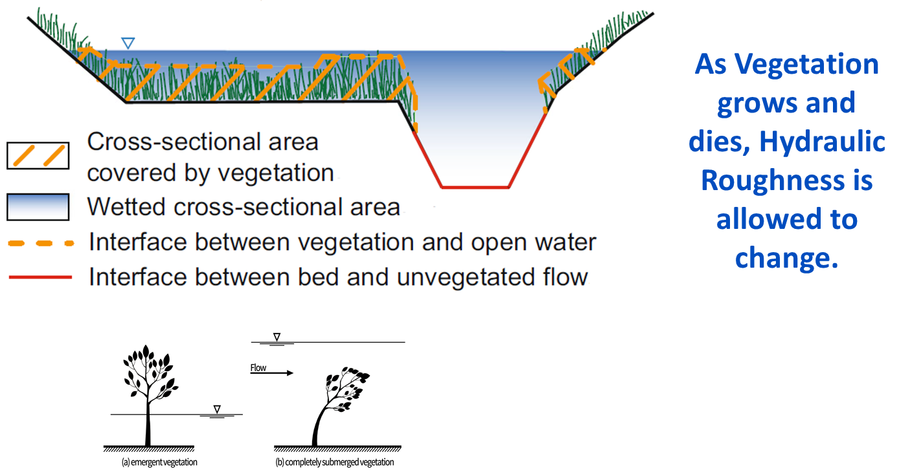
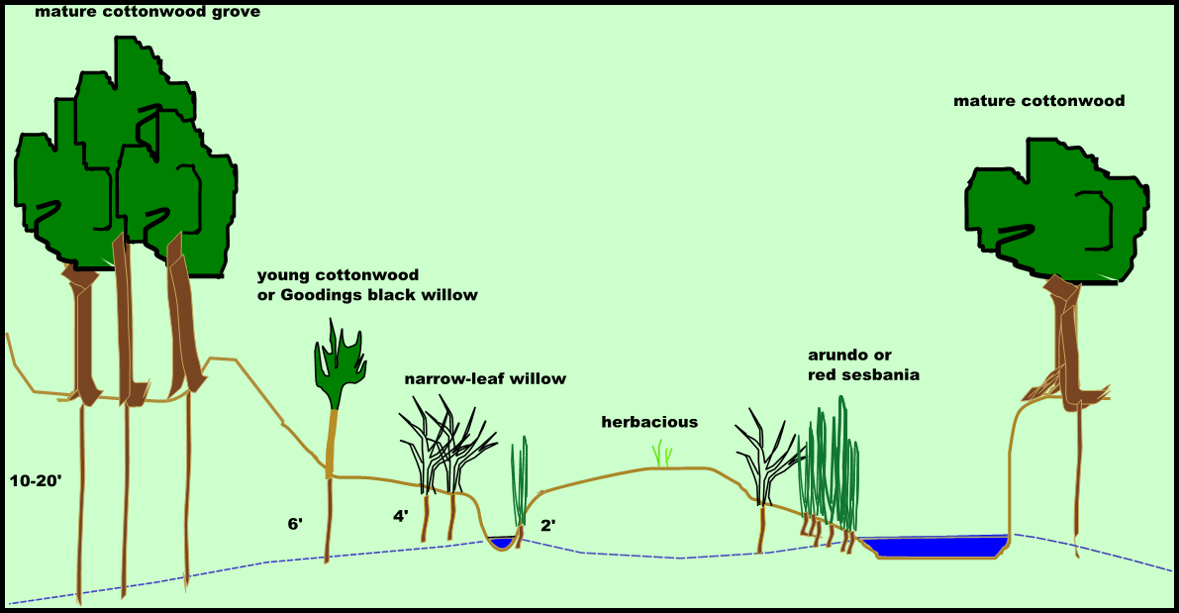
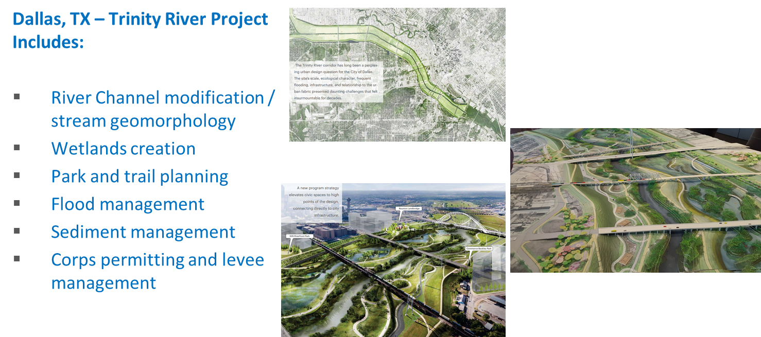
Models
The Environmental Laboratory (EL) is developing a framework and toolkit that will be able to integrate hydrologic, hydrodynamic, water quality and vegetation modeling with visualization and analysis capabilities to evaluate system vulnerabilities and identify adaptation pathways to improve the resilience of coastal ecosystems to environmental stresses, such as increasing frequency and intensity of coastal storm surges and extreme precipitation events, rising sea levels, decreasing freshwater flows, and increased salinity intrusion.
The integrated modeling system will simulate complex and dynamic interactions involving hydrology, hydrodynamics, salinity, sediment transport, soil chemistry and physics, vegetation, and water quality.

Slide 6
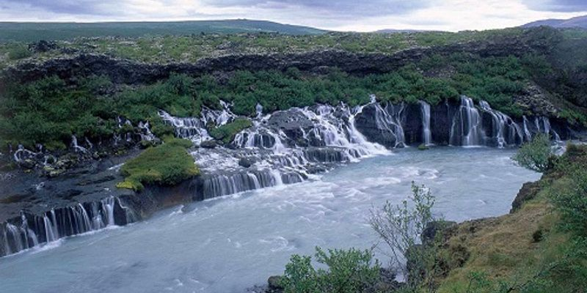
Models
ERDC-EL’s ClearWater (Computational Library for Environmental Analysis and Restoration of Watersheds) modules provide simulated temperature, nutrients, dissolved oxygen, salinity, and algae, as well as toxic organic contaminants.

Slide 7
Objectives
The objective of this project is to develop techniques to take flow and sediment information from GSSHA to drive existing and new nutrient fate and transport capabilities that will be built within the ClearWater modeling system.
In addition, this project will develop techniques to take flow, sediment, and nutrient information to drive the ERDC’s multi-species community-based models for aquatic and terrestrial vegetation.
In order to facilitate the efficient transfer of information, the setup of models, and the visualization of model results, this project will design and build databases to store large datasets and provide ready access for multiple models, design and build graphical user interfaces to facilitate input of a variety of nutrient and vegetation input, and design and build advanced data visualization capabilities for these datasets.

Slide 8
Major Project Tasks
Kick-Off Project Meeting
Finalize and Test Water Temperature capabilities within GSSHA
Develop In-Stream WQ Model
Design and Develop Overland and Sub-surface WQ Models
Develop and implement plan to link GSSHA-WQ with ERDCs multi-species vegetation model – Aquatic Plants
Develop and implement plan to link GSSHA-WQ with ERDCs multi-species vegetation model – Terrestrial Plants

Slide 9
Kick-Off Project Meeting
This meeting will present the Project Management Plan to the project team and collaborators in order to solicit consensus and modifications to the goals of the project.
As part of this meeting, we will discuss the approach we are taking in regards to developing flow and sediment solution files for driving the nutrient simulations within the ClearWater modeling system and then develop nutrient solution files, that in conjunction with GSSHA flow and sediment solution files, will be used to drive vegetation simulations within the ERDC Multi-species Vegetation Model for Aquatic and Terrestrial communities.
In addition to the technical discussions, this meeting will discuss leveraging opportunities between our collaborators with on-going reimbursable projects and work units, and identifying additional funding lines that can be used to expand our ability to model Nature Based Features for flow, sediment, nutrients, contaminants, and vegetation.

Slide 10
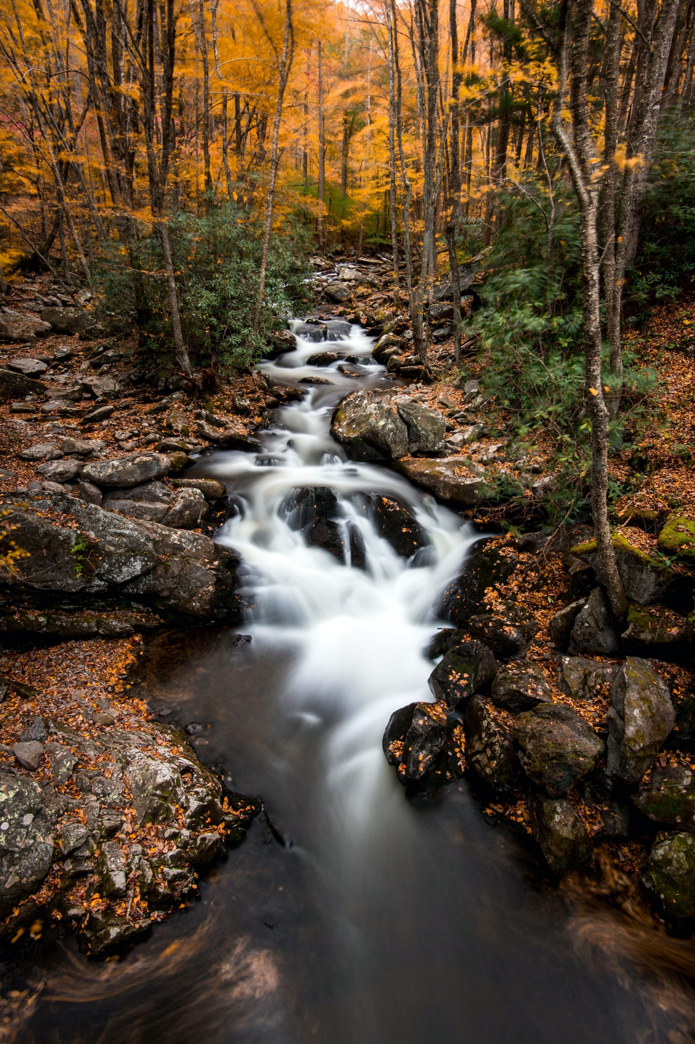
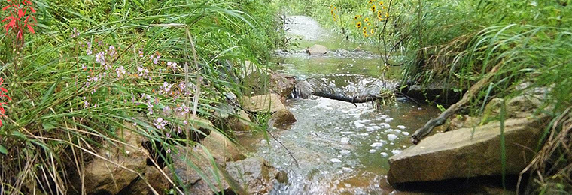
Finalize and Test Water Temperature capabilities within GSSHA
Finalize Overland Water Temperature integration with GSSHA
In-stream water temperature has been implemented within GSSHA and Overland water temperature is being finalized and tested.
Use Goodwin Creek Watershed (Mississippi) to test and validate in-stream and overland water temperature routines – Data has been gathered for the Goodwin Creek Watershed and will be used to test for any programming errors and to validate the water temperature process descriptions.

Slide 11
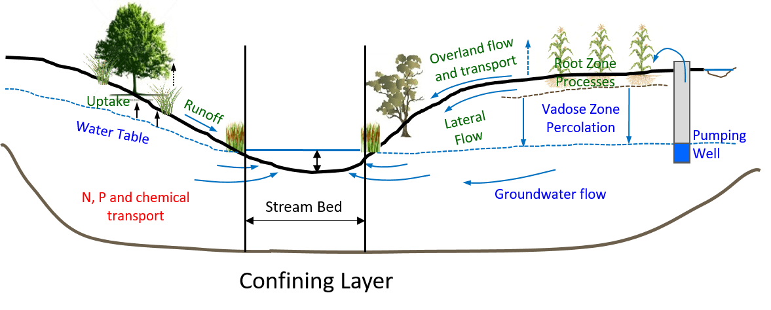
Develop In-Stream WQ Model
Modify existing in-stream nutrient model to run stand-alone – The current in-stream nutrient model will be modified to fit within the ClearWater modeling system as a stand-alone model that can accept flow and sediment solutions files from GSSHA.
Determine flow and sediment data, and frequency, needed from GSSHA to drive the in-stream nutrient model – An analysis will be done to identify the key information, and frequency of that information, that is needed to drive the in-stream nutrient model simulations. These data will be written into a database that will allow for large data storage and easy retrieval by the in-stream nutrient model.

Slide 12
Develop In-Stream WQ Model
Design a data storage system sufficient to store and retrieve the necessary data for GSSHA and the in-stream nutrient model - In order to facilitate the transfer of large amounts of data between models, GUIs, and Data visualization tools, a data storage system will be designed and built. We will investigate current systems and methods to ensure that we are on the cutting edge of managing large datasets.
Initiate development of a GUI for setting up the in-stream nutrient model and visualizing in-stream nutrient model output – A nutrient GUI will be developed that will allow users to easily setup the in-stream nutrient model, offer help and advice on estimating model parameters, and provide advanced data visualization for input data and model results.
Validate the GSSHA and in-stream model using existing field data – In conjunction with our project partners and collaborators, existing field data will be identified for model validation. It is anticipated that the San Antonio River Authority will be able to assist with this effort.

Slide 13
Design and Develop Overland and Sub-surface WQ Models
Design and develop a new Overland and Sub-surface nutrient model – The ClearWater models don’t currently account for nutrient processes in the overland and sub-surface regimes so new models will be built.
Finalize and test data storage and retrieval between GSSHA and the Overland and Sub-surface nutrient models – The data storage system will be upgraded to storage information relevant to the overland and sub-surface models.
Finalize and test the Overland and Sub-surface nutrient model user interface and data visualization tools – The user interface and Data Visualization tools will be upgraded to include the Overland and Sub-surface nutrient models.
Validate the GSSHA and Overland and Sub-surface models using existing field data - In conjunction with our project partners and collaborators, existing field data will be identified for model validation. It is anticipated that the San Antonio River Authority will be able to assist with this effort.

Slide 14
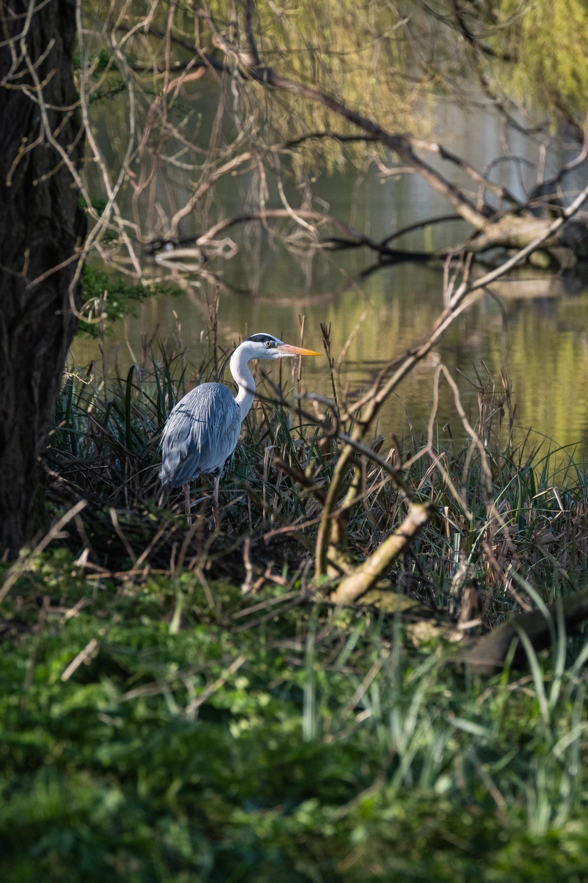
Develop and implement plan to link GSSHA-WQ with ERDCs multi-species vegetation model – Aquatic Plants
Determine proper flow, sediment, and water quality information that needs to be stored by GSSHA-Water Quality and develop and implement plan to link GSSHA-WQ with ERDC’s multi-species vegetation model – Aquatic Plant model – The project team will work with other EL team members to ensure that the needed GSSHA and the ClearWater modeling system’s solution files are provided to drive the aquatic plant dynamics.
Finalize and test data storage and retrieval between GSSHA and the Aquatic Plant model – The data storage system will be upgraded to store information needed for the aquatic vegetation model.

Slide 15
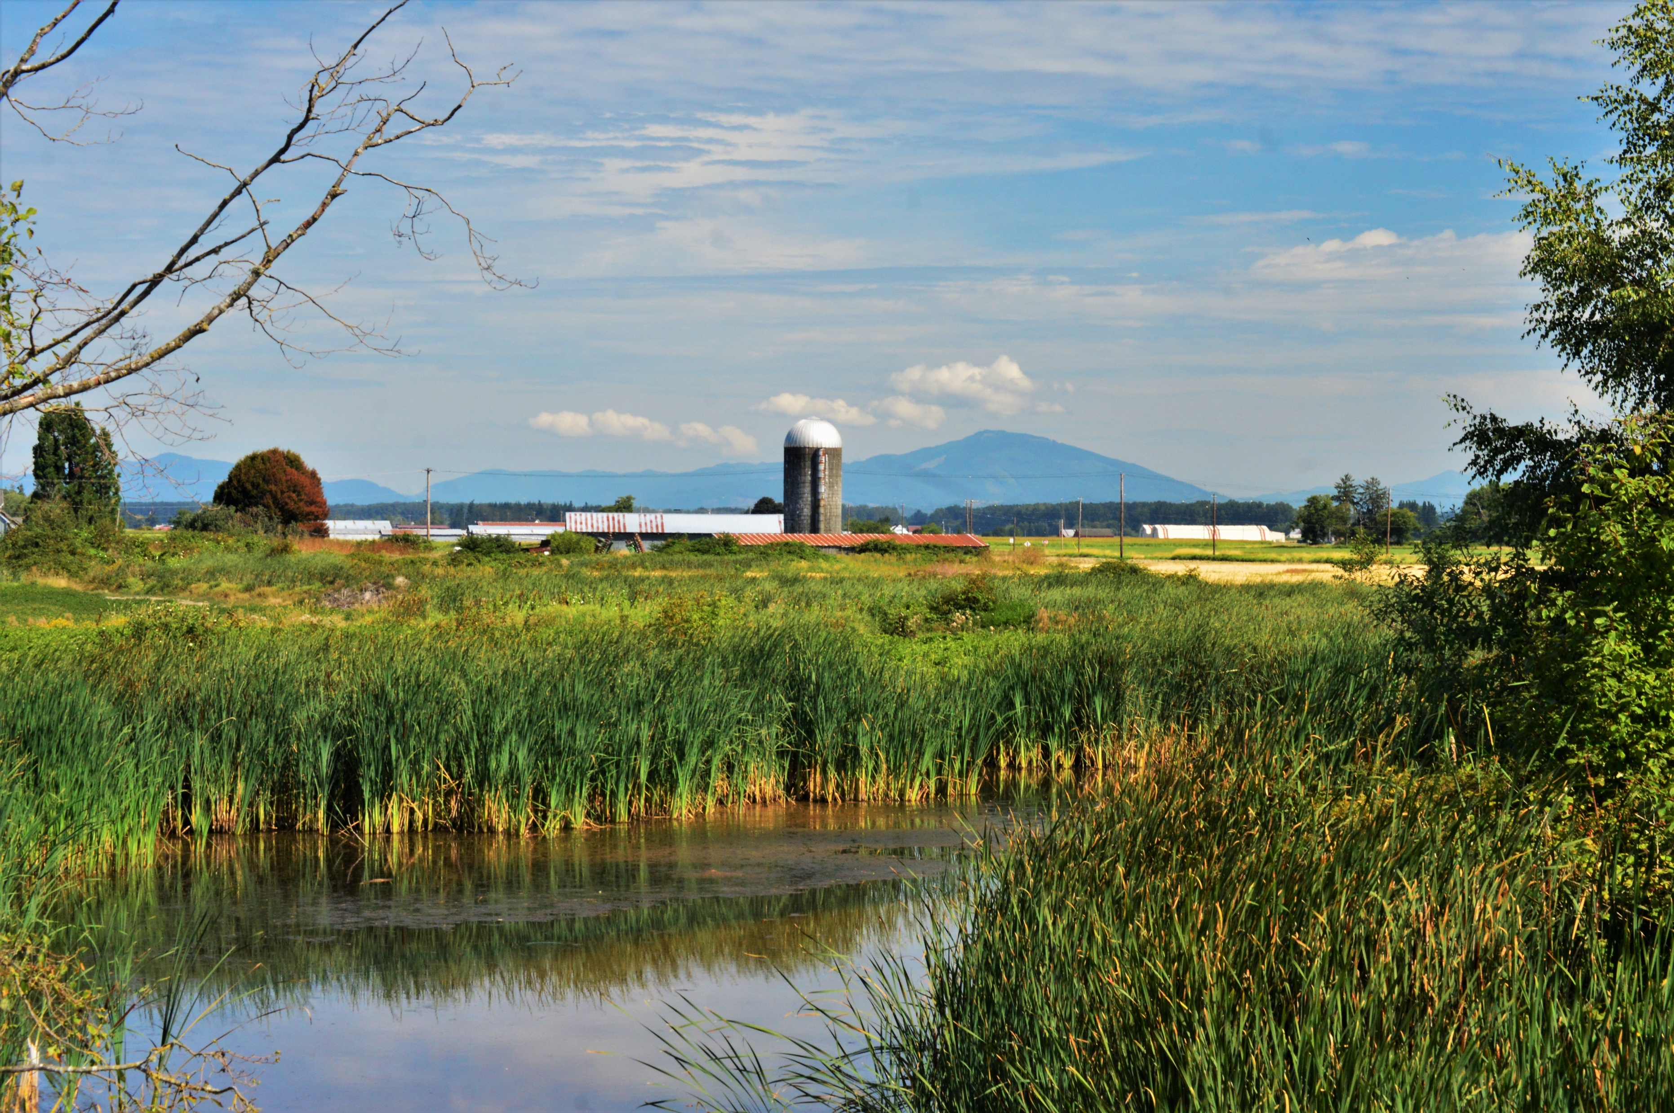
Develop and implement plan to link GSSHA-WQ with ERDCs multi-species vegetation model – Aquatic Plants
Finalize and test the Aquatic Plant GUI and data visualization tools – The GUI will be upgraded to include setup and data visualization for the aquatic plant model.
Validate the GSSHA-WQ and the Aquatic Plant model using existing field data – The project team will work with other EL team members to test and validate the linkage between GSSHA-WQ for Aquatic Vegetation simulations.

Slide 16

Develop and implement plan to link GSSHA-WQ with ERDCs multi-species vegetation model – Terrestrial Plants
Determine proper flow, sediment, and water quality information that needs to be stored by GSSHA-WQ and develop and implement plan to link GSSHA-WQ with ERDCs multi-species vegetation model – Terrestrial Plant model - The project team will work with other EL team members to ensure that the needed GSSHA and the ClearWater modeling system’s solution files are provided to drive the terrestrial plant dynamics.
Finalize and test data storage and retrieval between GSSHA and the Terrestrial Plant model - The data storage system will be upgraded to store information needed for the terrestrial vegetation model.

Slide 17
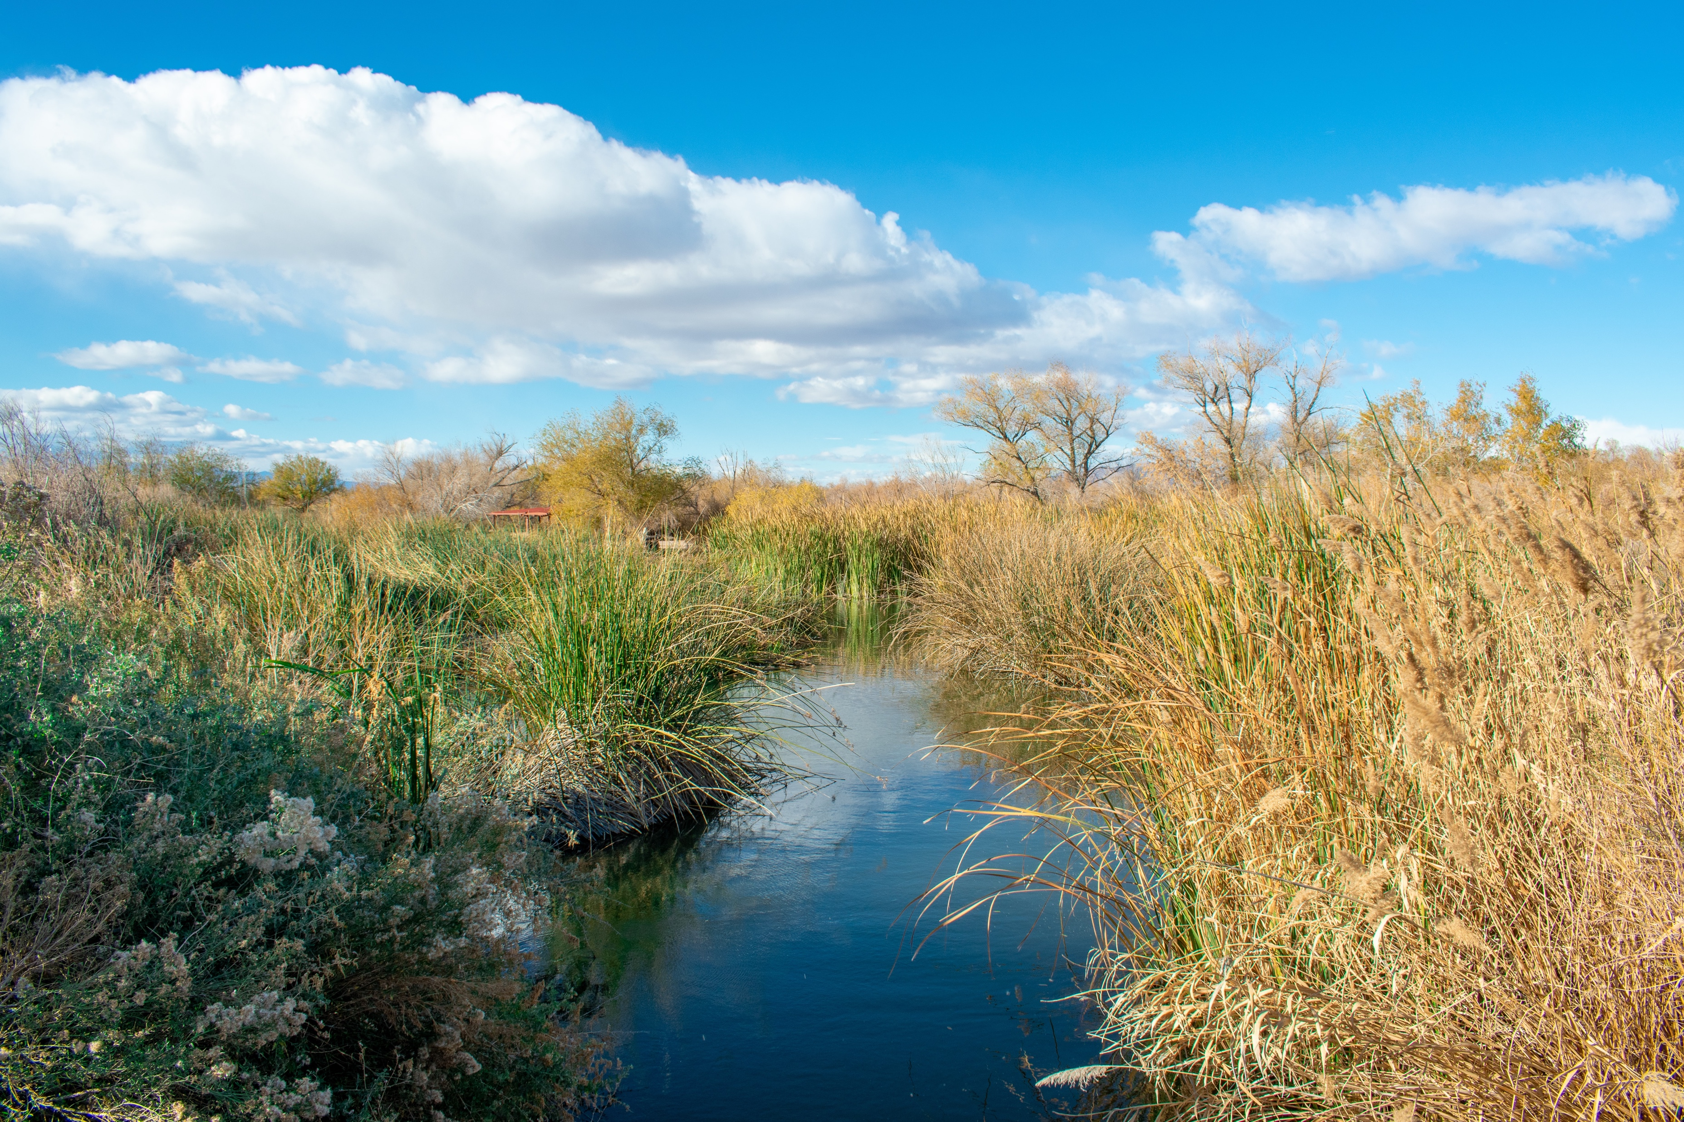
Develop and implement plan to link GSSHA-WQ with ERDCs multi-species vegetation model – Terrestrial Plants
Finalize and test the Terrestrial Plant GUI and data visualization tools - The GUI will be upgraded to include setup and data visualization for the terrestrial plant model.
Validate the GSSHA/Water Quality and the Terrestrial Plant model using existing field data - The project team will work with other EL team members to test and validate the linkage between GSSHA-WQ for Terrestrial Vegetation simulations.

Slide 18
Scheduling

Slide 19
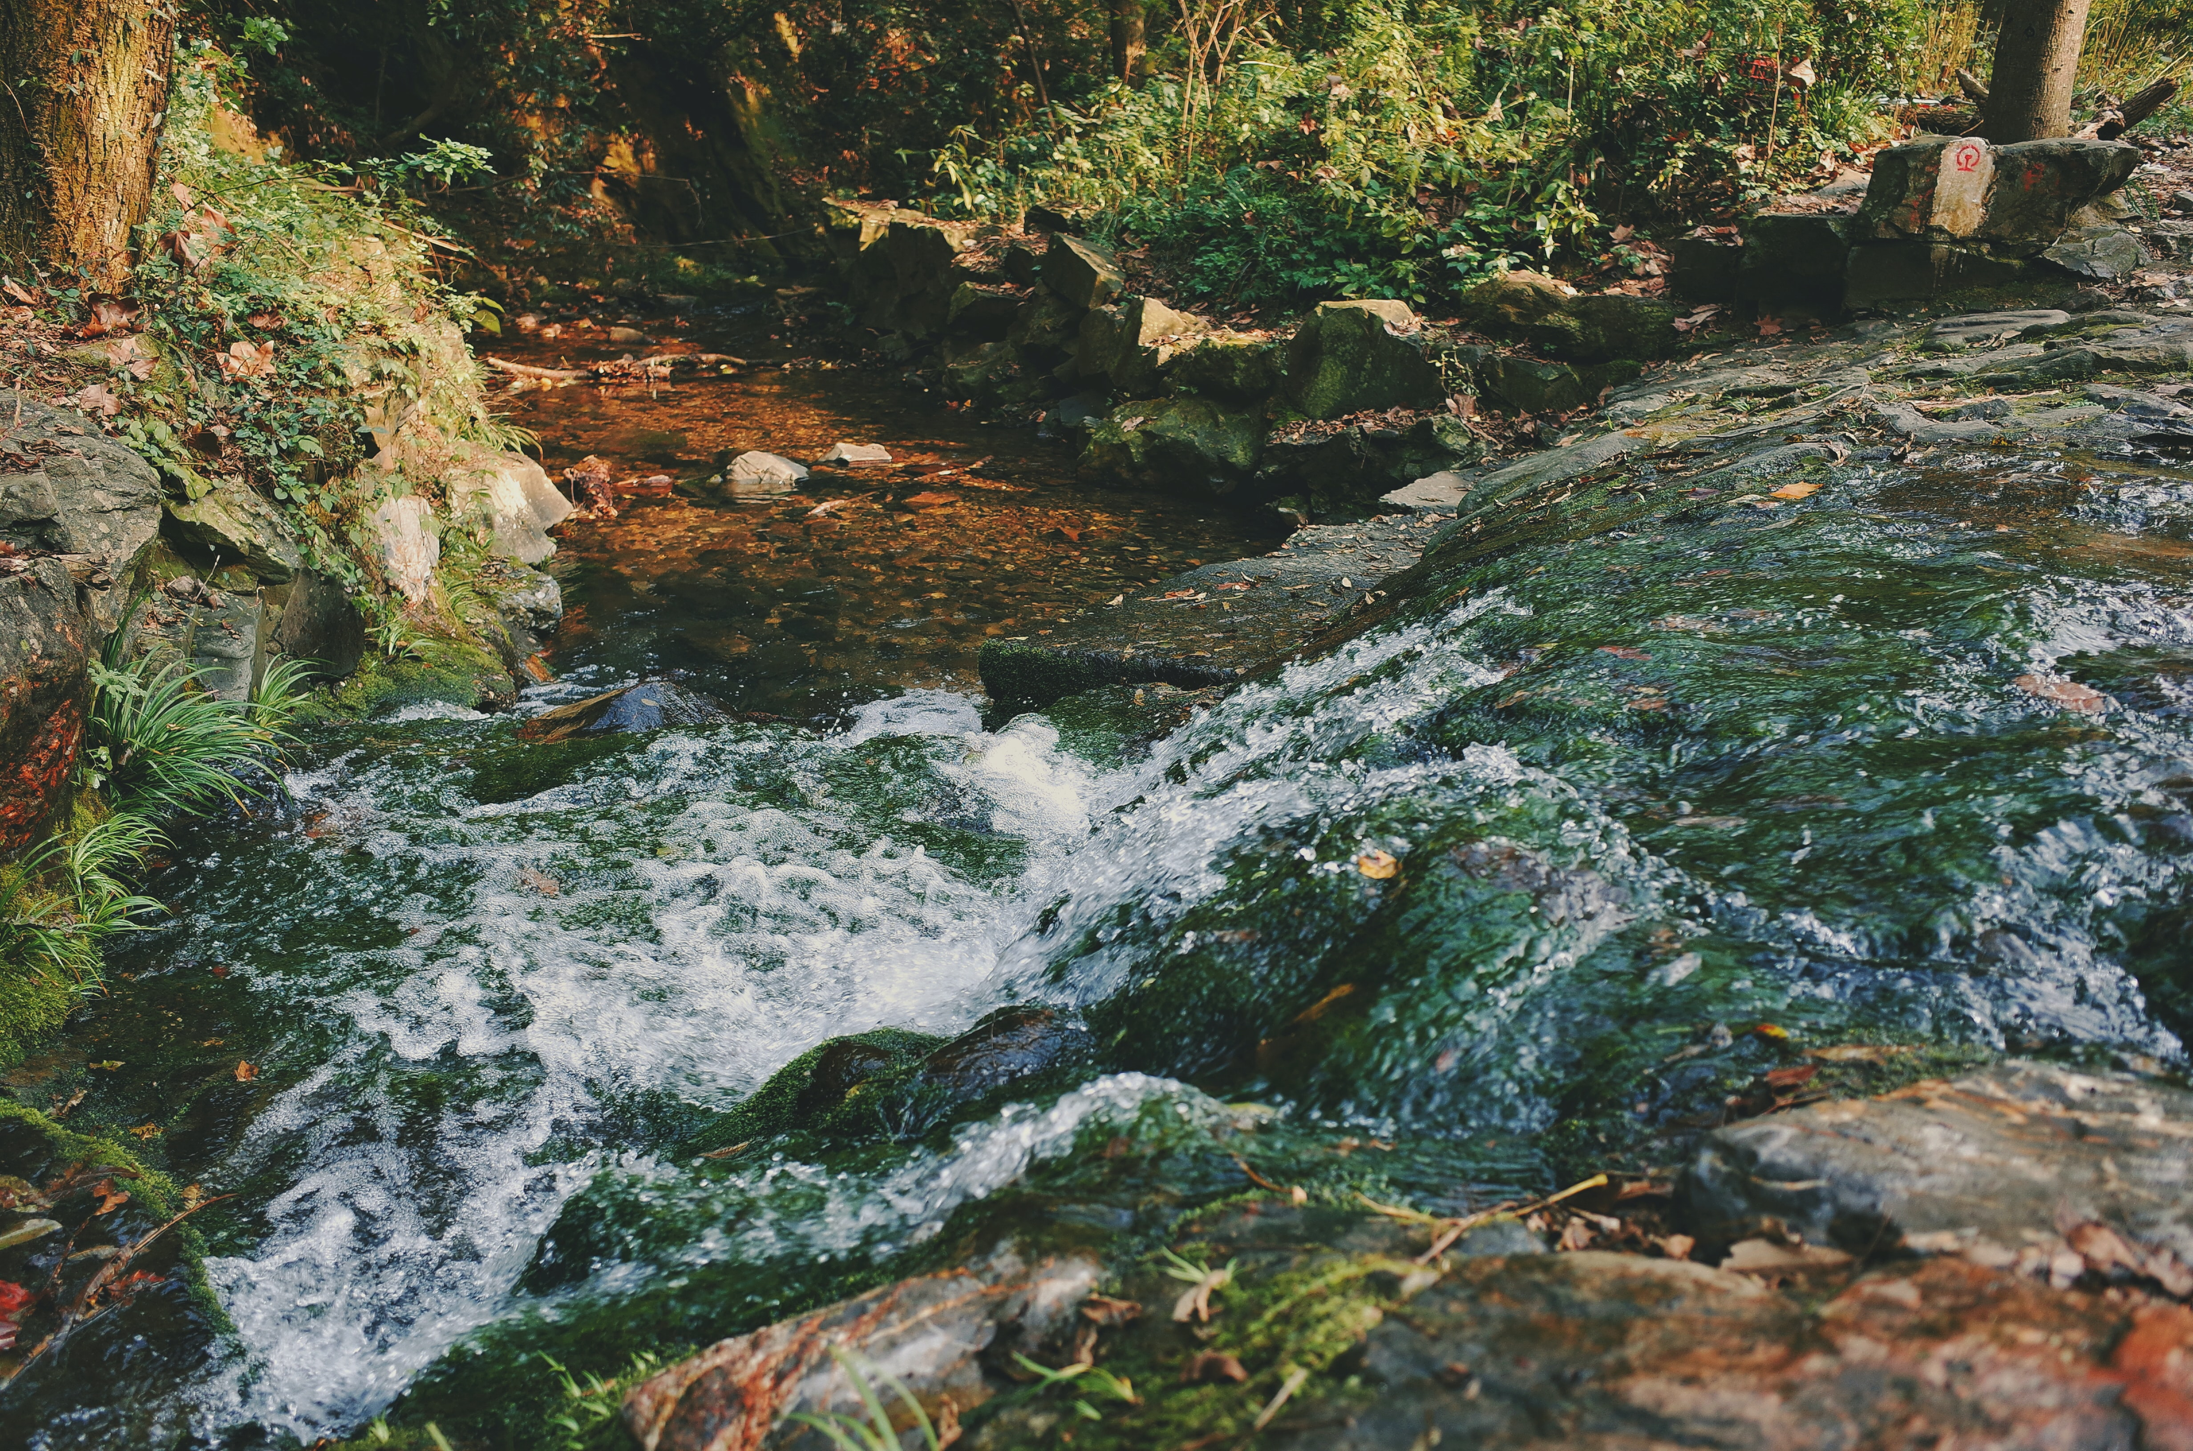
DISCUSSION and COMMENTS

